Slide 1
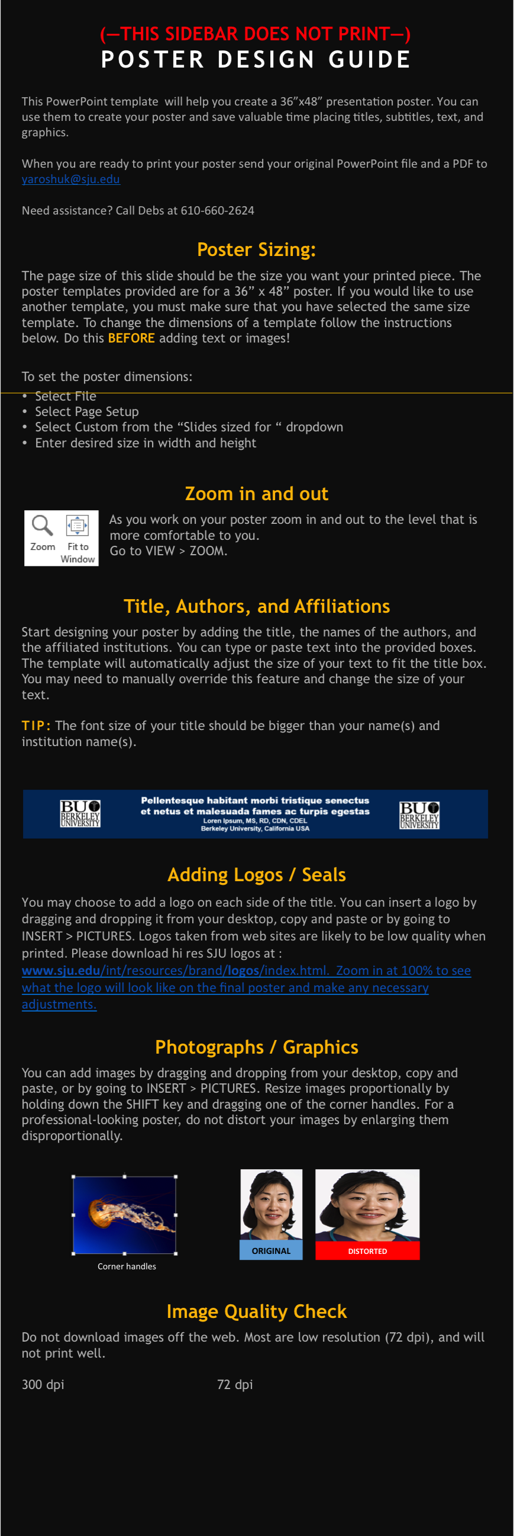
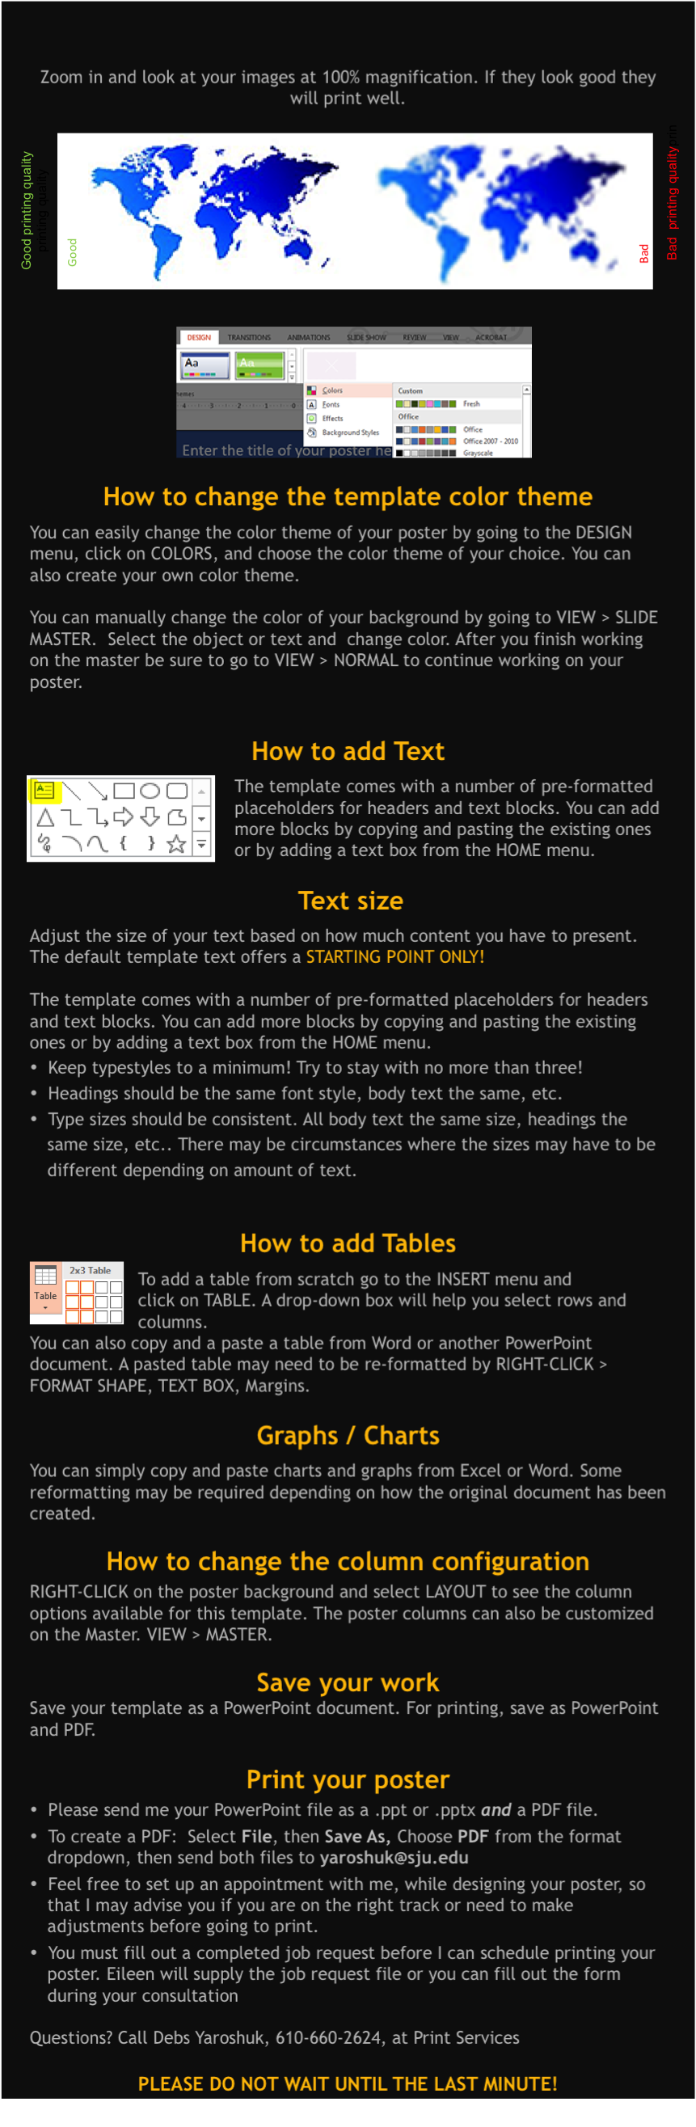
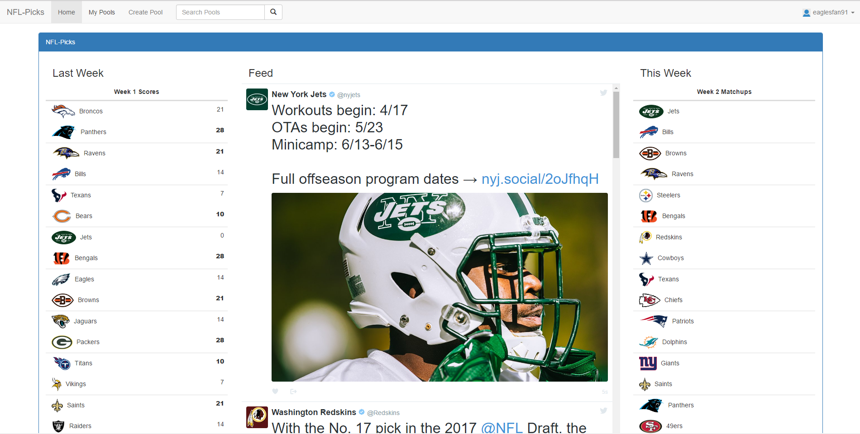
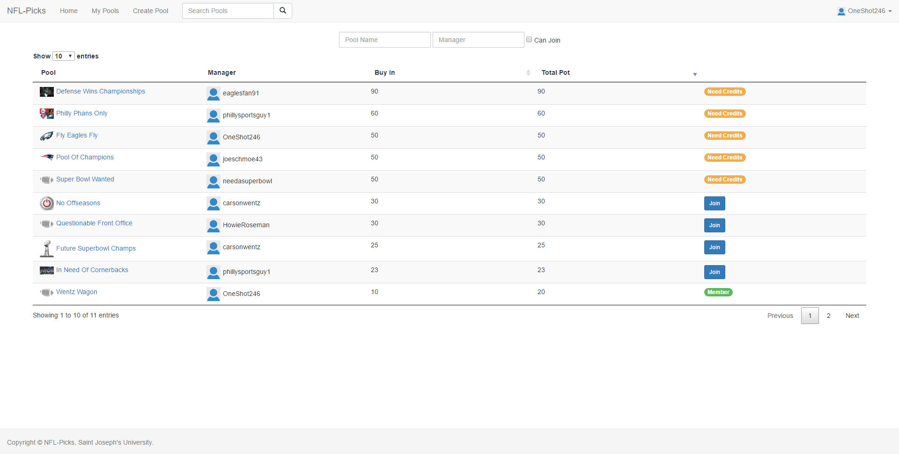
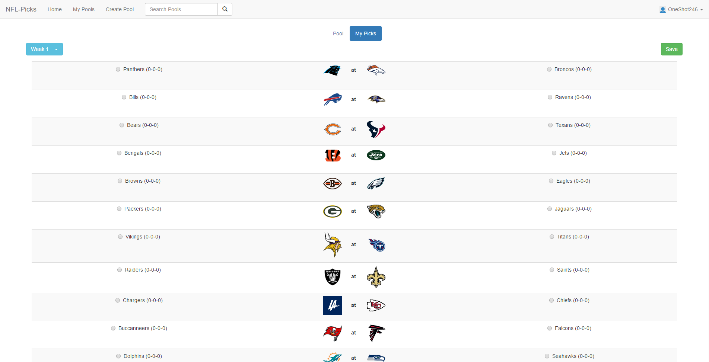
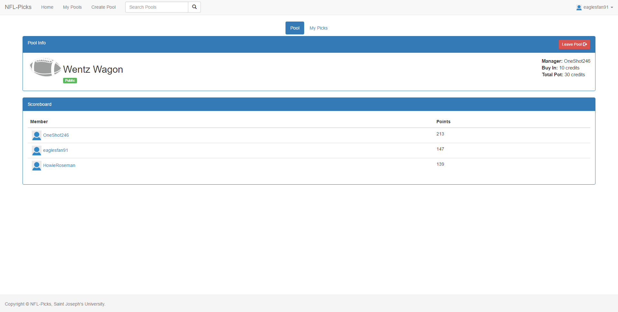


NFL-Picks
Colin Deckert; Lou Dignam; Sean Monahan
Saint Joseph’s University, Department of Computer Science
The Rules
Displaying the Data
Making it User Friendly
The NFL season lasts 17 weeks, with 30 teams. Our project is a website that hosts user-made pools.
Users will use on site credits to buy into a pool.
The user chooses one team every week that they have not yet chosen.
Once they choose this team, they may not choose the team again for the rest of that season for that pool.
If that team wins, the user earns the same amount of points as that team scored.
If the team the user chose loses, the user scores 0 points.
At the end of the season, the user with the most points wins the pool.
The total credits in the pot will be divided up fairly between the top 3 scoring users
PHP is a widely used scripting language that can be easily used to connect to a database and retrieve the data stored in it.
PHP can also be embedded into HTML, which is the standard mark-up language used to create webpages.
Therefore, PHP allowed us to easily fetch the data from our database and display it on our site.
We also chose PHP because it has built-in tools designed specifically for connecting and retrieving data from a MySQL database.
PHP acted as a seamless link between our data and our front-end user interface.
JavaScript is a programming language that serves as one of three core technologies in web development, the other two being HTML and CSS
JavaScript allowed us to make our web pages more dynamic and easy to use
It can be used to manipulate the HTML DOM, allowing us to change our web pages on the fly without having to reload the page
Moreover, manipulating the HTML DOM became especially easy with the use of jQuery, a cross-platform JavaScript library
jQuery combined with Ajax calls allowed us to retrieve data from our database and dynamically display that data on our web pages asynchronously
Storing the Data
Giving it Style
We chose to use a MySQL database to store our data
MySQL is a commonly used database technology
MySQL offers scalability and flexibility. Meaning it is capable of supporting both small amounts of data and extremely large amounts of data.
MySQL is also fast and easy to manage. This allowed us to quickly get our database up and running and place more focus on the design and functionality of our site.
The simple management tools MySQL provides also allowed us to easily test and evolve our database as we discovered what was needed to implement the features we desired.
Bootstrap is an open-source front-end web framework
Bootstrap contains CSS design templates for common HTML elements
This made designing our site simple and straightforward and resulted in a clean look that is easy to view and understand
Also, since Bootstrap is open-source, there are a variety of plugins that have been made for it
These plugins allowed us to add some functionality that would have taken much more time and effort if we were to write the code for them on our own
Sign in and play!
Join a pool
Make your Picks
Win!

